Slide 1
Exam Grades
High score: 100 (x5) [2018: 99, 2017: 100]
Mean: 86.5 [2018: 82.5, 2017: 83.4]
Median: 90 [2018: 86 , 2017: 88]
Std. Dev. : 11 [2018: 12 , 2017: 15]
Scores
90-100: 27 [2018: 27, 2017: 28]
80-89: 19 [2018: 21 , 2017: 12]
70-79: 8 [2018: 14 , 2017: 13]
< 70: 7 [2018: 10 , 2017: 10]
Great job!
Good/bad news: only 20% of your course grade

Slide 2
How are our investments doing?

Slide 3
StockTrak
Purpose: practice creating and implementing an investment strategy
Form teams of 3-4
Set up one account on StockTrak per team
We’ll track performance over the semester
Highest performing team receives extra credit
Sign up on Google spreadsheet. Link in PDF.

Slide 4
Market News
Currently, futures markets:
47% of another rate cut
Peloton
Notes:
Peloton Deepens IPO Slump in 3rd-Worst Unicorn Debut Since ‘08
Value at launch: $8.1B
2019 net loss widened to $245.7 million, from a net loss of $47.9 million in the prior year
Shares of Peloton, known for its exercise bikes where users can watch workout videos from home, started trading Thursday at $27 a share, nearly 7% lower than the $29 price set in the company’s IPO. The Nasdaq-listed stock fell 7.5% Thursday afternoon to $26.82 a share.
Peloton’s IPO price was at the top end of the company’s $26-to-$29 expected range.

Slide 5
Portfolio Optimization Ch. 2: Preferences and Ch. 3: Mean-Variance Investing
July 2014

Slide 6
Asset Management
Over the next 8 weeks, we will learn how to make optimal investment decisions given our preferences and the distribution and dynamics of various return factors
Ch 2: Preferences
Ch 3: Mean-Variance Investing
Ch. 6: Factor Theory
Ch. 7: Factors
Ch. 10: Alpha
Ch. 14: Factor Investing
Factor: common movement in returns across a set of assets
Fundamental, economy wide variables (e.g., inflation) or tradeable investment styles (e.g., value-growth)
These are the risks we should care about and be compensated for

Slide 7
Outline
Utility theory = characterizing bad times
Mean-variance utility (not very realistic, but the industry standard)
Other more realistic utility functions
Utility concepts:
Risk aversion
Certainty equivalent
Optimal Portfolios
With risk-free asset
Without risk-free asset

Slide 8
Motivating Example
Compare:
Short volatility strategy: investment strategy which nets a premium during stable periods (period after 2009), but has large losses during volatile times (financial crisis 2008-2009)
Technically, we can implement this by selling out-of-the-money put options
S&P 500 equities

Slide 9
Volatility Strategy vs S&P 500

Slide 10
Distributions

Slide 11
Volatility Strategy vs S&P 500
Average return is approximately the same, at around 10%
Dispersion, as measured by standard deviation = 15%, is also approximately the same
But the volatility strategy exhibits large negative skewness, that is prone to occasional frightful losses
 | Vol Strategy | S&P 500
Mean | 9.9% | 9.7%
Std. Deviation | 15.2% | 15.1%
Skewness | -8.3 | -0.6
Kurtosis | 104.4 | 4.0

Slide 12
Volatility Strategy vs S&P 500
How does an investor judge each investment’s “risk”
How much of each, if any, should an investor hold?
How do we take into account the asymmetric payoffs? Especially those associated with downside risk?

Slide 13
When we get paid matters
Hypothetical lottery:
0.0001% chance you win $5M, $0 otherwise
How much would you be willing to pay?
E[payoff] = $5
Hypothetical disability insurance contract:
0.0001% chance you become disabled and get a payout (PV of payouts = $5M), $0 otherwise
How much would you be willing to pay?
Most people are willing to pay more for the disability insurance
Pays out when we need money the most
In investing, we’ll want to consider how the investment’s payoffs correlate with our good and bad times (i.e., low and high marginal utility)
In bad times, an extra dollar makes us feel a lot better than an extra dollar in good times

Slide 14
Utility Functions

Slide 15
Preferences
Utility is how economists measure investors’ bad times. The lower the utility from a specific outcome, the more it hurts.
Utility = How you feel
Utility is an index that measures bad times
High utility: good times. Usually low marginal utility.
Low utility: bad times. Usually high marginal utility.
Marginal utility: change in utility from an increase in an underlying variable like wealth, consumption, etc.
A utility function, U, measures the felicity or satisfaction of an individual. It assigns a numeric measure to an agent’s desire.
Notes:
Utility maps outcomes of asset returns which occur with some probability to a numerical index
Takes into account how large the returns are: what can happen
And how often they happen: probability
Combined with how investors perceive those outcomes: weighting returns, probability, and subjective preferences

Slide 16
Utility Functions
We start with utility as a function of wealth, W, and then move to considering other variables which affect utility
Rich: good time
Poor: bad time
Utility increases with wealth, but the rate of increase is different for different investors
Utility functions increase with wealth: property of non-satiation
Utility functions are typically concave: going from $1 to $2 is much more valuable than going from $100,000 to $100,001
Law of diminishing marginal utility
A utility function provides a systematic way to rank different choices. The actual numerical value (“cardinality”) has no meaning; for wealth W, U(W) and a U(W) + b have exactly the same rankings. (See Appendix.)

Slide 17
Utility Functions
Popular utility functions:

Slide 18
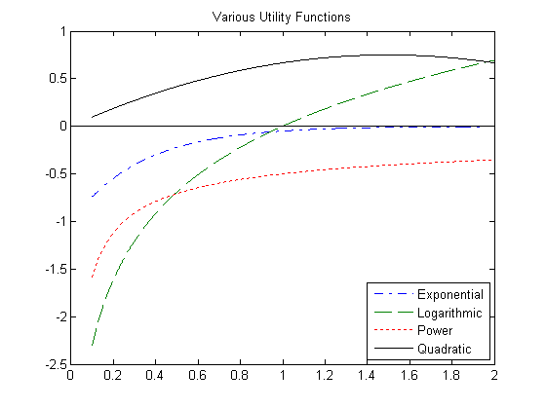
18
18

Slide 19
Utility Functions
A sure value of (x+y)/2 is preferred to a 50-50 chance of x or y. The shape of concavity is a measure of risk aversion, which trades off risk and return.

Slide 20
Risk Aversion
Risk aversion is a key concept in utility functions. The opposite of risk aversion is risk tolerance
The more risk averse the investor, the flatter the utility function
A very risk-averse investor has a steep utility function, or high marginal utility
Moving from right to left (rich to poor), your utility changes a lot. You feel the pain of bad times horribly.
A very risk-tolerant investor has a flat utility function, or low marginal utility
Moving from right to left (rich to poor), your utility doesn’t change very much. Your bad times don’t feel that bad.

Slide 21
Risk Aversion
Risk aversion is a crucial parameter for utility functions. For mean-variance utility (and CRRA utility), it is the only parameter.
Typically, most individuals would have risk aversions between 1 to 10 with it being very rare to have risk aversions greater than 10. This comes from a large body of experimental and survey evidence.
Metrick (1995), studies the game show Jeopardy, and finds low risk aversion levels
There are a variety of ways to measure risk aversion
Questionnaires, especially those employed by financial planners
Certainty equivalent comparisons
Revealed preference: portfolio holdings or bets made

Slide 22
Risk Aversion
What’s your risk aversion?
How much would you pay for the following bet? [Calibrated with CRRA utility]
$1000
p=.5
γ | Amount you would pay
0 | 750
0.5 | 729
1 | 707
2 | 667
3 | 632
4 | 606
5 | 586
10 | 540
15 | 525
20 | 519
50 | 507
$500
Example of certainty equivalent comparison

Slide 23
Certainty Equivalent
The utility certainty equivalent is the sure amount of wealth that is equivalent, in utility terms, to a risky position. It is the amount C satisfying

Slide 24
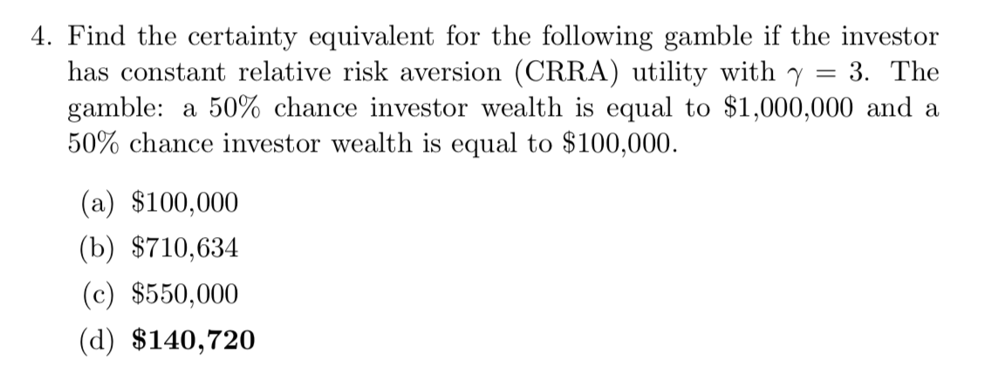
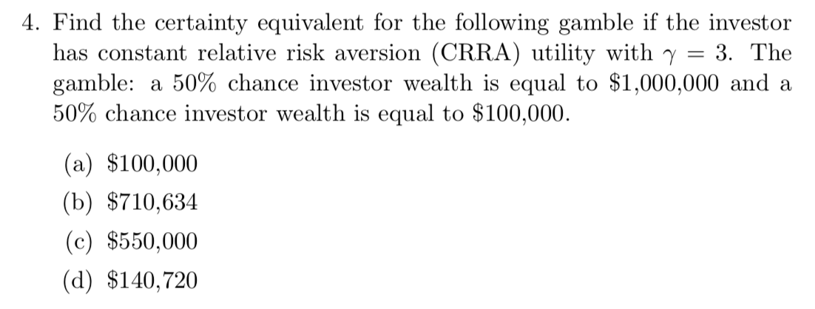
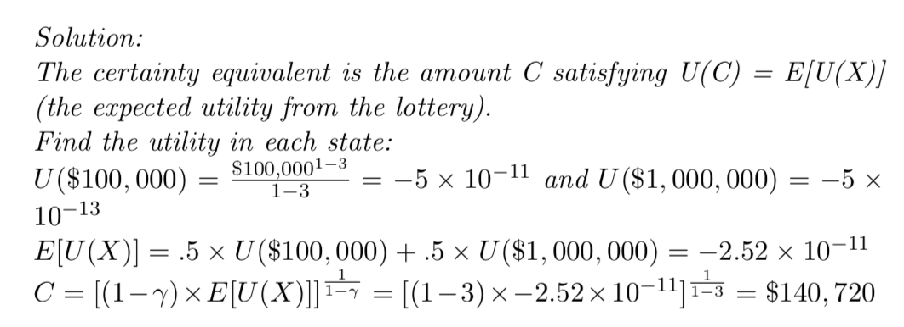
Homework Problem

Slide 25
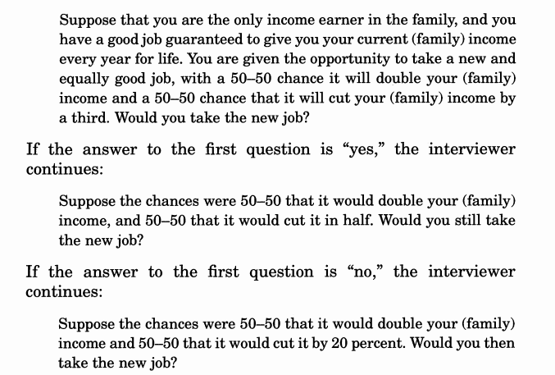
Barsky, Juster, Kimball and Shapiro (QJE, 1997)

Slide 26
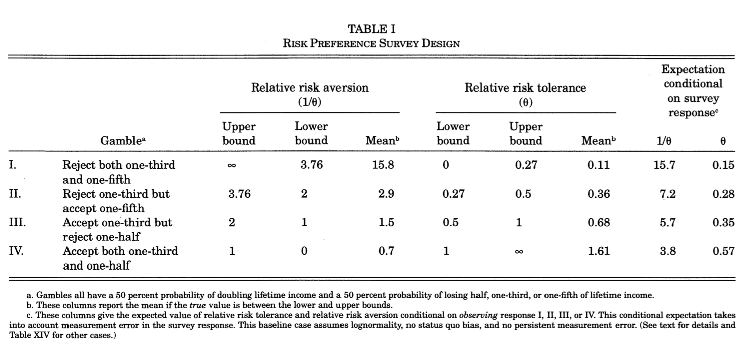

Slide 27
Risk aversion in practice
Schwab Risk Tolerance Questionnaire
https://www.schwab.com/public/file/P-778947/InvestorProfileQuestionnaire.pdf
The answers are not mapped to a utility function and a risk aversion coefficient
Instead, gives the planner some broad idea of a person’s level of risk aversion

Slide 28
Expected Utility
Since wealth is random, the utilities over wealth are also random. We specify that agents care about expected utility. Expected utility is the main workhorse of modeling individual choices in economics.
The agent maximizes expected utility by choosing different
Spending/savings plans => optimal savings/consumption problem
Holding different assets => optimal asset allocation problem
Production plans => optimal firm investment problem
etc.
Agents do not, however, always behave in accordance with expected utility (see later)

Slide 29
Utility Functions
How are Preferences Used?
Portfolio Choice Problem:
Two assets: stocks and bonds with portfolio weights w_{S} and w_{B} (percentages)
This set up allows us to incorporate our preferences into the optimal portfolio problem
Answer depends on
Risk aversion (concavity of U) and other properties of U
Properties of the assets (investment universe)
Each investor has a different U. They may have access to the same or different assets.

Slide 30
Mean-Variance Utility

Slide 31
Mean-Variance Utility
The most commonly used utility function in industry is mean-variance utility.
Defined in terms of returns or initial wealth, does not matter.
Why is this a desirable property for use in asset management?
Mean-Variance Utility:
where r_{p} = portfolio return, γ = risk aversion

Slide 34
Mean-Variance Utility
There are an infinite number of indifference curves. One particular indifference curve represents a particular level of utility.
Along an indifference curve, an investor is indifferent to all mean-volatility (or mean-variance) combinations
The more risk averse an investor, the steeper the slope of the indifference curve
Mathematically:
Along an indifference curve, U is held fixed and E(r) and var(r) change to give the same value of U:

Slide 35
Certainty Equivalent
For mean-variance utility, take the indifference curve going through the risky asset. [Why is there only one?] The certainty equivalent is the point where the indifference curve intersects the y-axis.
Note that the certainty equivalent risk-free rate is identical to the utility level! Thus, the level of utility is meaningful in mean-variance utility (unlike general utility functions)

Slide 36
36
36

Slide 37
Choosing Between Portfolios

Slide 38

Choosing Between Portfolios
We want to find the portfolio that maximizes our utility:
E[r]
Better off
15%
A
A
10%
B
B
3%
12%
20%
σ

Slide 39
Optimal Portfolio of Risky Assets

Slide 40
Mean-Variance Utility
Maximizing utility is the same as finding the highest possible indifference curve. But, there are an infinite number of indifference curves.
The portfolio choice problem usually specifies constraints:
Assets
Maximize Utility
Constraints
Optimal asset holdings

Slide 41
Mean-Variance Utility
Example
Data 1926:01-2011:12 (Ibbotson data)
Investor can only hold stocks or bonds. For a given risk aversion, what holdings are optimal? Assume the investor cannot short.
The asset space and constraints pin down the set of feasible indifference curves. In this case, it is the mean-variance frontier. For the solution, see Appendix B.
 | Mean | Std. Dev.
Stocks | 0.1119 | 0.1915
Bonds | 0.0591 | 0.0833
Correlation(stocks,bonds)=0.1113

Slide 42
Mean-Variance Frontier
A = Stocks
B= Bonds….
For two assets, the mean-variance frontier is traced by taking all combinations of the two assets A and B:
Asset A: E(r_{A}) and σ_{A}, held with weight w
Asset B: E(r_{B}) and σ_{B}, held with weight 1-w
Correlation between A and B: ρ
Portfolio p: E(r_{p}) and σ_{p}
[What does it mean for w<0 or w>1?]

Slide 43
Mean-Variance Utility

Slide 44
Mean-Variance Utility

Slide 45
Mean-Variance Utility

Slide 46
Beyond Mean-Variance

Slide 47
Mean-Variance Utility Drawbacks
Symmetry of upside and downside movements
Variance treats upside and downside returns the same, relative to the mean. People are generally more risk averse over downside losses than over upside gains.
Only first two moments matter
People prefer positive skewness than negative skewness. People dislike fat tails, especially on the downside.
Real-world vs. subjective probabilities
The actual return distributions of assets are different to those perceived by agents
More realistic utility functions (see appendix for more details):
Safety first
Loss aversion or prospect theory
Disappointment aversion
Habit
Keeping up with the Jones
Uncertainty Aversion

Slide 48
Ambiguity Aversion
Sometimes we don’t know the probability distribution, beliefs about possible probability distributions – Knightian uncertainty (ambiguity)
Example: You have an urn containing 30 red balls and 60 other balls either white or black.
Choose between these two gambles
A: Receive $1,000 if you draw a red ball
B: Receive $1,000 if you draw a black ball
Choose A if and only if you believe # of white > # of black
Different choice: choose between these two gambles
C: $1,000 if you draw a red or white ball
D: $1,000 if you draw a white or black ball
Choose C if and only if you believe # of white > # of black
Most people choose A (# white># black) and D (# black< # white)
Ellsberg paradox – evidence of ambiguity aversion
Prefer gambles with known odds to gambles with ambiguous odds (uncertainty about the probability distribution)

Slide 49
Summary

Slide 50
Redux: volatility strategy vs S&P 500
A mean-variance investor would be relatively indifferent between the two
What about an investor that is averse to crash risk?
 | Vol Strategy | S&P 500
Mean | 9.9% | 9.7%
Std. Deviation | 15.2% | 15.1%
Skewness | -8.3 | -0.6
Kurtosis | 104.4 | 4.0

Slide 51
Summary
Utility functions quantitatively rank good to bad outcomes
Incorporating utility functions allows us to account for our preferences in the portfolio optimization problem
The more risk averse an investor, the lower the utility during bad times, and the greater the difference in utility between good and bad times. Risk aversion can be measured by questionnaires, certainty equivalents, and revealed portfolio holdings.
In mean-variance utility, there is only one preference parameter: risk aversion. Investors care only about means (which they like) and volatility (which they dislike). It is the most widely used utility function in industry, sadly.

Slide 52
Appendix A: More on Utility Functions

Slide 53
Further Details on Utility Functions
The economic properties of a utility function are related to its derivatives
U(W) is increasing in wealth if U’(W) > 0
U(W) is strictly concave in wealth U’’(W) < 0
The degree of risk aversion is formally defined by the Arrow (1971) and Pratt (1964) risk aversion coefficients:
For CRRA utility, relative risk aversion is given by γ:

Slide 54
Further Details on Utility Functions
The expected utility formulation was first provided by von Neumann and Morgenstern (1947) and axiomatized by Savage (1954). An important axiom is the independence axiom: that wealth in one state does not interact with wealth in another state so as to reverse the preference. This is violated in practice.
Another important assumption is that expected utility assumes the probabilities and payoffs are known. But, often agents do not know exact probabilities, and can only specify vague sets of different probability models. This setting is described by “Knightian uncertainty” (see Gilboa and Schmeidler, 1989).

Slide 55
Realistic Utility Functions

Slide 56
Safety First
Developed by Roy (1952)
Minimizes the chance of a disaster. Establish a level d: if the portfolio return is less than d, then a disaster results and if greater than d, no disaster. The utility function is 0-1 depending on whether the return exceeds d or not.
Value-at-Risk is similar
Natural application is when meeting a liability is crucial
Related utility functions include quantile utility, formulated by Manski (1988) and Rostek (2010). Agents maximize a given quantile of the distribution (the quantile is a utility parameter).

Slide 57
Loss Aversion or Prospect Theory
Developed by Kahneman and Tversky (1979)
Downside losses are more painful than the joy coming from upside gains
“Behavioral” or non-rational utility
Two parts to prospect theory:
Loss aversion utility. This specifies how investors treat losses and gains. Slope of the function over losses is steeper than the slope over gains.
Subjective rather than objective (actual or real-world) probabilities. Investors can over-weight the probabilities of disasters, for example.

Slide 58
Loss Aversion or Prospect Theory
Investors are risk-seeking over losses, but loss averse over gains
People are willing to take on some risk to avoid sure losses

Slide 59
Loss Aversion or Prospect Theory

Slide 60
Disappointment Aversion
“Rational” version of prospect theory, with the same motivation that agents care more about the downside vs the upside
Originally formulated by Gul (1991) with an asset allocation application by Ang, Bekaert and Liu (2005)
Like prospect theory, downside outcomes are penalized more (“disappointing outcomes”) vs. upside outcomes (“elating outcomes”). There is a kink point between disappointing vs. upside outcomes, which is specified endogenously (the certainty equivalent) or is a preference parameter.

Slide 61
Disappointment Aversion

Slide 62
Habit
It is not your wealth per se which gives utility, it is wealth relative to a habit level that is important. An agent gets used to a particular level of consumption – recent changes relative to that level contribute to consumers’ well being.
The habit level could also be interpreted as a required “subsistence” level. As consumption comes close to subsistence, the agent acts in a much more risk averse manner. However, the risk aversion is “endogenous” in that it results from the agent’s actions, rather than from the risk aversion parameter.
Habit can vary over time and be both “internal” (depends on past consumption levels) or “external” (is driven by external factors)
Volatility strategies are generally unattractive for habit utility investors because when volatility spikes, equities tend to crash, and these are times when wealth creeps closer to habits

Slide 63
Catching/Keeping Up with the Jones
Utility is set relative to your peers
Endowment and mutual fund managers are benchmarked against their peers
You want to outperform, or consume more than, your peers. Thus, your utility will be high when you are poor, but everyone is even poorer.
In asset management, keeping up with the Joneses causes herding
If everyone else is doing the volatility strategy, you’re going to do it, too.
Very important utility function in practice

Slide 64
Uncertainty Aversion
Distinguish between
Risk: the probability of a given outcome for a given distribution
Uncertainty: there are multiple possible distributions
Risk aversion measures the pain of bad outcomes over the probability distribution; uncertainty aversion, or ambiguity aversion, measures how an investor does not like the range of possible distributions
Expected utility is uncertainty aversion with only one probability distribution

Slide 65
Appendix B: Portfolio Calculations

Slide 66
Two-Asset Portfolio Problem with Mean-Variance Utility
Problem: Two assets r₁ and r₂ with means μ₁ and μ₂ and volatilities σ₁ and σ₂, respectively with covariance σ₁₂:
Setting the FOC equal to zero results in the optimal portfolio weight on the first asset being

Slide 67
Optimal Portfolios with Risk-Free and Risky Asset
Math: Maximize utility subject to the CAL constraint
We solve for the optimal weight by finding the derivative with respect to w, set it equal to zero, and solve for w* = optimal weight
Assume risky asset has mean 11.19% and volatility 19.15% and risk-free rate is 1%

Slide 68
Optimal Portfolios with Risk-Free and Risky Asset
Optimal holding of risky asset:
Solution for A = 7
Solution for A = 2
What is the intuition for the solution in terms of
Expected returns?
Volatility?
Risk aversion?

